Slide 1

R dplyr
March 26, 2025
Jessica Whiteaker

Slide 2
Getting Started!
install.packages("dplyr")
library(dplyr)

Slide 3
Key Functions
%>% : The pipe. Read as “and then.”
filter() : Pick observations (rows) by their values.
select() : Pick variables (columns) by their names.
arrange() : Reorder the rows.
group_by() : Implicitly split the data set by grouping by names (columns).
mutate() : Create new variables with functions of existing variables.
summarize() / summarise() : Collapse many values down to a single summary.

Slide 4
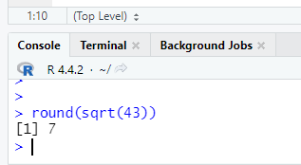
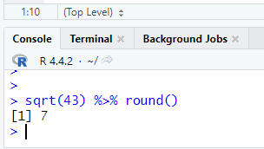
%>% ….. and then
Keyboard shortcut Ctrl+Shift+M

Slide 5
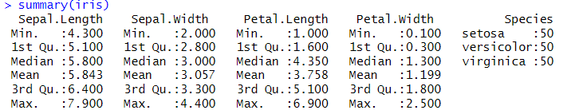
Summary() function
Generic function used to produce result summaries of the results of various model fitting functions.
The summary function returns the minimum, maximum, mean, median, and 1st and 3rd quartiles for a numerical vector.

Slide 6
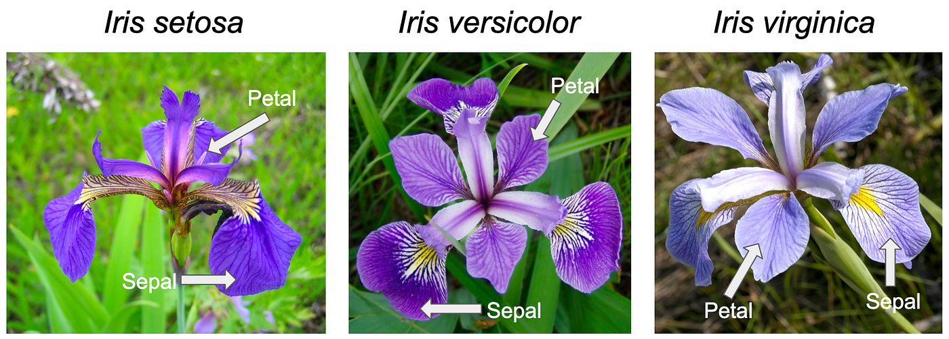
Edgar Anderson's Iris Data
Dataframe with 150 cases (rows) and 5 variables (columns) named Sepal.Length, Sepal.Width, Petal.Length, Petal.Width, and Species.

Slide 7
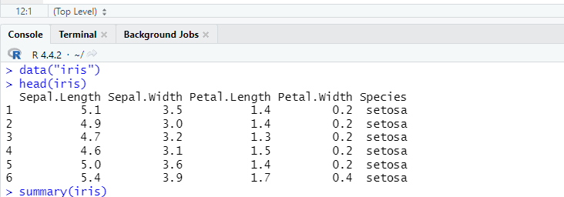
Row vs. Column
Column
Row

Slide 8
filter()
Pick observations (rows) by their values.
This can be either numeric or text
If text put “in quotes”
Can use any R operators (!=, ==, >=, <=, etc.)

Slide 9
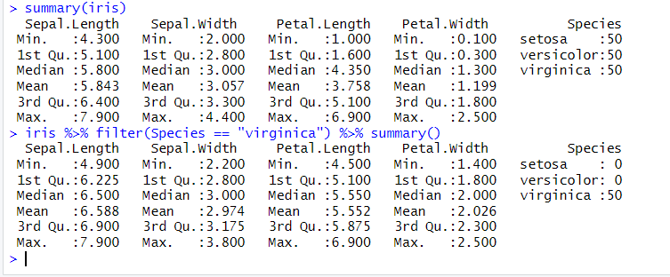
iris %>% filter(Species == "virginica") %>% summary()

Slide 10
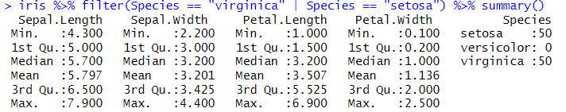
iris %>% filter(Species == "virginica" | Species == "setosa") %>% summary()

Slide 11
select()
Pick variables (columns) by their names.
Can use position in data.frame as well
Can use functions to find like items
starts_with()
ends_with()
contians()
Etc.

Slide 12
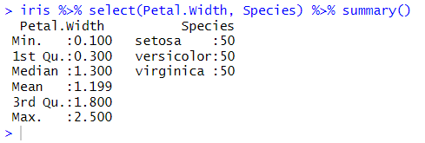
iris %>% select(Petal.Width, Species) %>% summary()

Slide 13

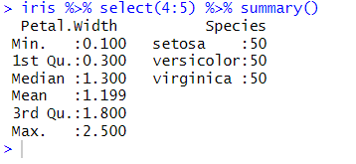
iris %>% select(4:5) %>% summary()

Slide 14
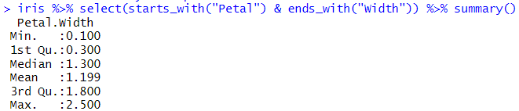
iris %>% select(starts_with("Petal") & ends_with("Width")) %>% summary()

Slide 15
arrange()
Reorder the rows.
Ascending (default)
Descending (desc())
Can be preformed over multiple columns
Dates
Numbers
Alphabetical order

Slide 16
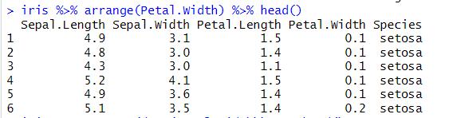
iris %>% arrange(Petal.Width) %>% head()

Slide 17
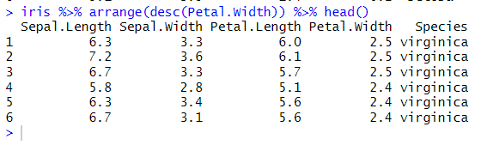
iris %>% arrange(desc(Petal.Width)) %>% head()

Slide 18
group_by()
Implicitly split the data set by grouping by names (columns).
Can group by multiple items
Good first step in data processing
Other functions can be applied from here

Slide 19
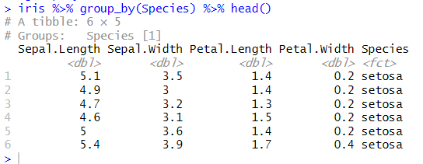
iris %>% group_by(Species) %>% head()

Slide 20
summarize() / summarise()
Collapse many values down to a single summary.
Creates aggregated data.
There are a lot of functions
summarize_all()
summarize_at()
summarize_if()

Slide 21

iris %>% summarise(mean = mean(Sepal.Length))

Slide 22
Useful functions
Center: mean(), median()
Spread: sd(), IQR(), mad()
Range: min(), max(), quantile()
Position: first(), last(), nth()
Count: n(), n_distinct()
Logical: any(), all()

Slide 23
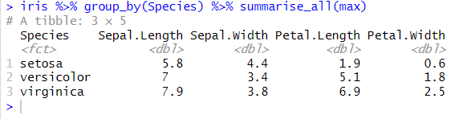
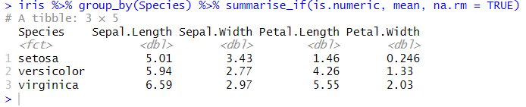

Examples

Slide 24
mutate()
Create new variables or column with functions of existing variables.

Slide 25
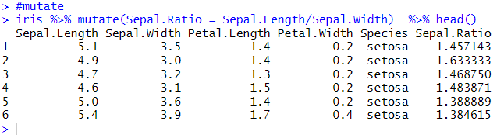
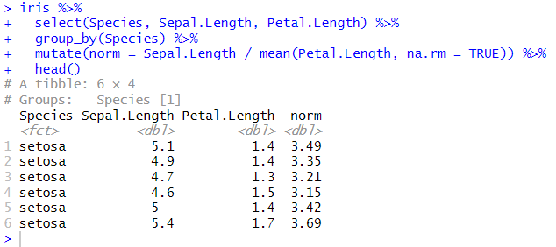
iris %>% mutate(Sepal.Ratio = Sepal.Length/Sepal.Width) %>% head()

Slide 26
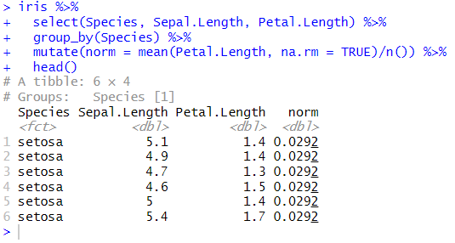
Examples

Slide 27
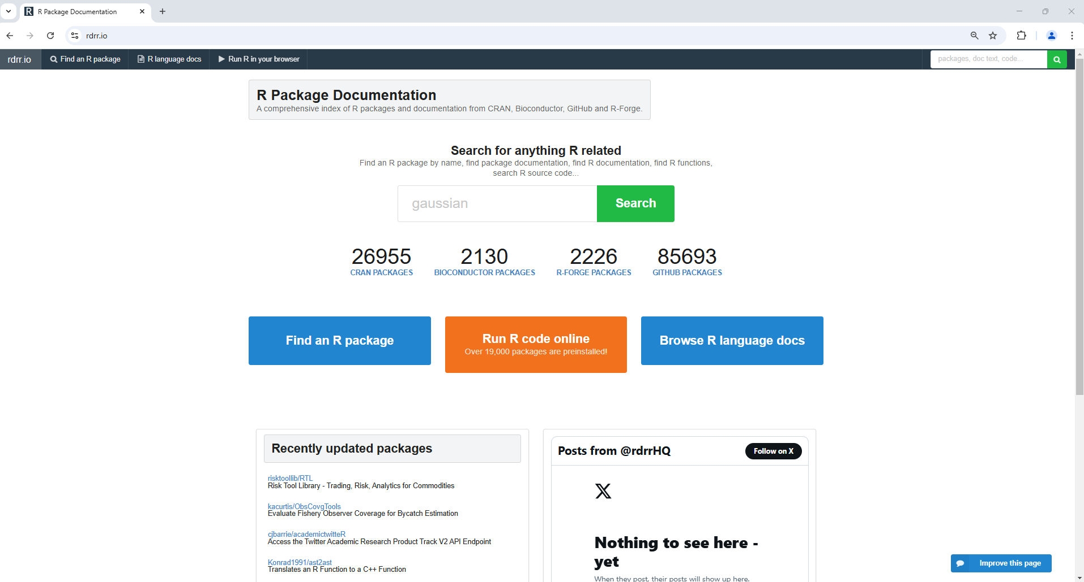
Packages in R

Slide 28
Questions!?!?

Slide 29
Rows
filter() chooses rows based on column values
slice() chooses rows based on location
arrange() changes the order of the rows

Slide 30
Columns
select() changes whether or not a column is included
rename() changes the name of columns
mutate() changes the values of columns and creates new columns
relocate() changes the order of the columns

Slide 31
Group of Rows
group_by() specify which category or group
ungroup() change dataset to not group by specified category
summarize() collapses a group into a single row

